Slide 1

COMP 90049
Knowledge Technologies
Week 5
我们毕业啦
其实是答辩的标题地方
Tutor
Ang Li

Slide 2
Name: Ang Li
E-mail: angl4@student.unimelb.edu.au
Contact information
Research topic: computer vision

Slide 3
Summery
Quick review for last week
Work through this week’s exercise
Notes:
Secure File Transfer Protocol
Secure Shell

Slide 4
For the vector space model, is it a default rule that we have to count the stop words (it, is, the...) into our word list?
For N-Gram Distance, if n = 3 and here the word is "lended", is it correct that substrings like "##l", "#len" should be included (just the single terminal, or up to n-1 terminal characters) ?
For nerbourhood search, if k = 3, we should also include the returned results of k=1 and k=2 right?

Slide 5
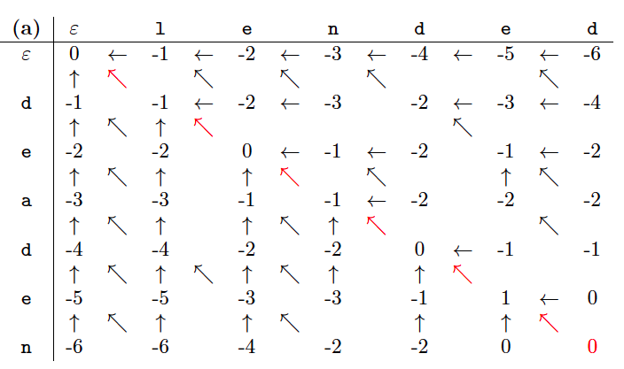

Slide 6
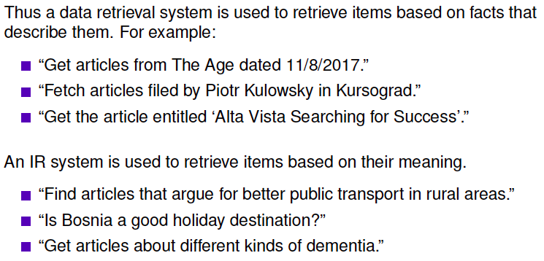
Exercise 2. What is the difference between “data retrieval" and “information retrieval"? Why is the latter a knowledge task, but the former is not?

Slide 7
The main difference here is the existence of people: the users. Because people are wildly divergent, the notion of a relevant result in information retrieval depends on contextualizing the data to the particular user (which may be very difficult, because we have an imperfect model of the user and indeed the user has an imperfect model of their needs!).
Whereas with data retrieval, there is a particular unit of data (bit stream) that we need to access in memory or on a hard drive, and there is generally no ambiguity.

Slide 8
Exercise 4. Identify some different types of “informational needs.”
Give examples of queries which might indicate a particular type of informational need. Are some of them ambiguous for the type of need?
Input some queries of different types of informational needs into a web search engine like Google. Are search engines better at responding to some types of informational need than others? Is there any indication that the search engine is identifying the type of need and tailoring the results toward that?

Slide 9
Informational, e.g. “global warming”
Navigational, e.g. “ebay home page”
Transactional, e.g. “Mac powerbook”
Geospatial, e.g. “Carlton restaurant”
Topic tracking, e.g. “what is the outcome of Worldcup final?"
This isn't an exhaustive list. Nor is it non-overlapping: for example, any query can be construed as being navigational in nature (as the user is likely to click through to a relevant document), and most are informational as well.
The three categories that are typically given are informational, navigational, transactional; but, again, these are somewhat arbitrary themselves.

Slide 10
Exercise 4. Identify some differences between Boolean querying and ranked querying.

Slide 11
Exercise 4. Identify some differences between Boolean querying and ranked querying.
Boolean: documents match if they contain the terms (and don't contain the NOT terms; i.e. the Boolean formula evaluates to TRUE); matching is Yes/No; repeatable, auditable, controllable; queries allow expression of complex concepts.
Ranked: based on evidence that the document is on the same topic as the query; matching is gradiated (to come up with a ranking!); different models give different results; queries are easy to write and results are easy to read for non-specialists.

Slide 12
Exercise 5. Identify the two components of “TF-IDF" models. Indicate the rationale behind them as in, why would they contribute to a “better" result set?.

Slide 13
Exercise 5. Identify the two components of “TF-IDF" models. Indicate the rationale behind them as in, why would they contribute to a “better" result set?.
More weight is given to documents where the query terms appear many times (TF).
Less weight is given to terms that appear in many documents (IDF).

Slide 14
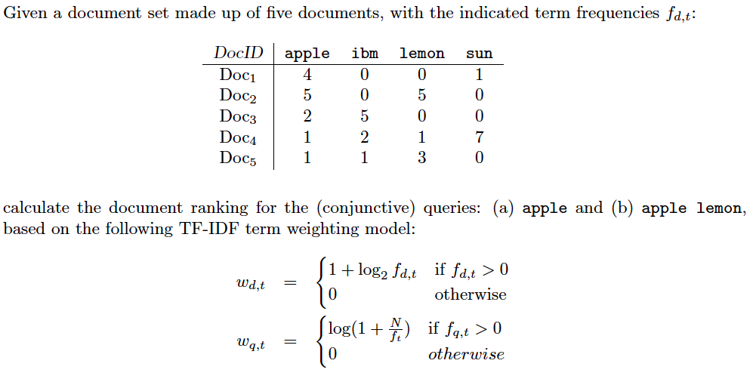
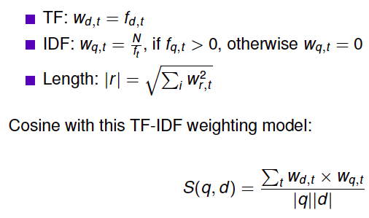

Slide 15
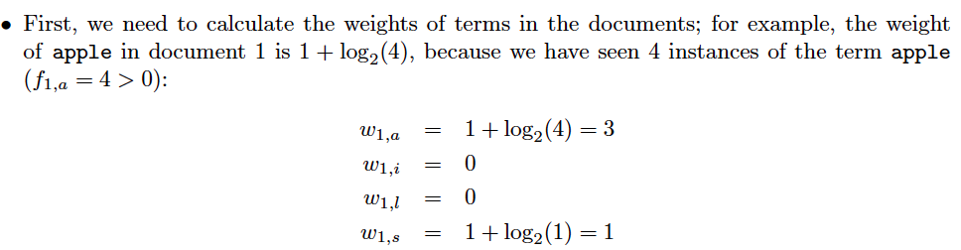

Slide 16
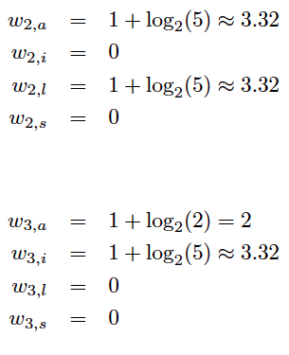
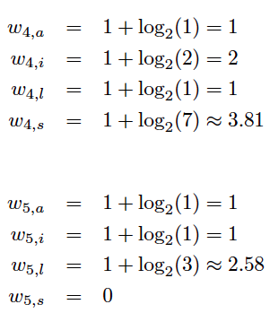

Slide 17
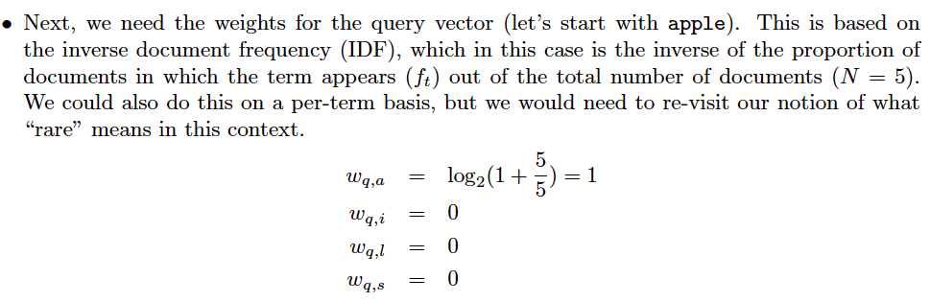

Slide 18
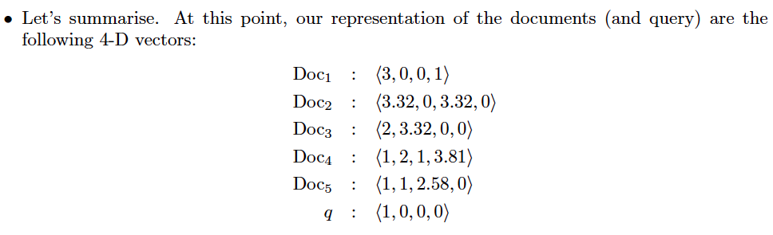

Slide 19
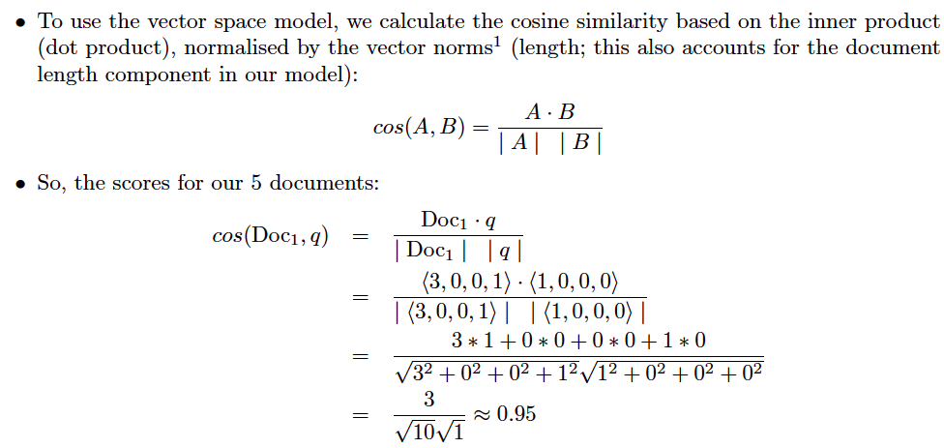

Slide 20
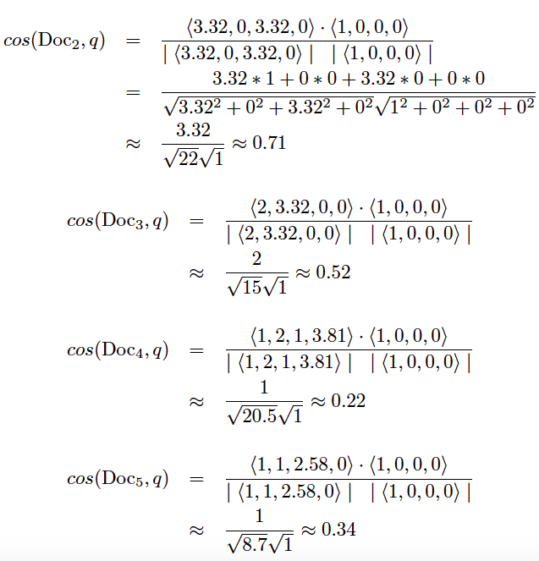

Slide 21
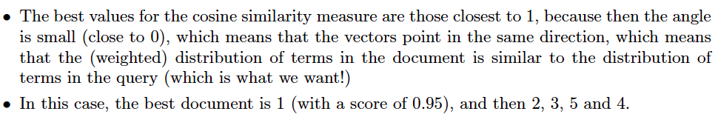

Slide 22
Thanks!

